Slide 1
OpenETCS project Summary of WP3 priorities concerning traceability
Meeting of 25 September 2015 + complements
Prepared by Raphael Faudou
(Samares Engineering)

Slide 2
Key points summary
OpenETCS traceability process versus standard process
WP3 main priorites concerning traceability

Slide 3
Standard SE process (ISO 15288:2015) without models
derive
Direct traceability
Stakeholders Needs
System concepts (problem space)
Stakeholders
requirements
System requirements
System definition
(Solution definition)
System level requirements
Decomposed and derived requirements
SW building block requirements
Software or hardware block definition and realization
SW low-level requirements
SW Code

Slide 4
OpenETCS requirements with regards to ISO 15288:2015 engineering levels
derive
Direct traceability
Stakeholders Needs
User stories
Cenelec EN 50128
System concepts (problem space)
Stakeholders
requirements
SRS – Subset 26
System definition
(Solution definition)
System requirements
System level requirements
openETCS decomposed and derived requirements
Decomposed and derived requirements
SW building block requirements
Software block definition
And realization
OpenETCS API
SW low-level requirements
SW Code

Slide 5
Standard SE process with models
derive
Traceability (between requirements or through models)
Stakeholders Needs
System needs model
UC / User Stories / Operational Scenarios
Operational modes
Stakeholders
requirements
System boundaries model
System main functions
Interface definitions
System requirements
System level requirements
System Architecture Model
Functional/logical architecture
Physical configuration items
Constraints/Equations
Allocations
Decomposed and derived requirements
SW building block Requirements
SW Architecture Model
Architecture / Design
SW low-level requirements
SW Code

Slide 6
OpenETCS current process vs. standard
derive
Traceability (between requirements or through models)
User stories
Stakeholders Needs
System needs model
UC / User Stories / Operational Scenarios
Operational modes
User stories model
Cenelec EN50128
Stakeholders
requirements
System boundaries model
System main functions
Interface definitions
Architecture
(semi formal) model
System requirements
SRS – Subset 26
Data dictionnary model
System level requirements
openETCS decomposed and derived requirements
System Architecture Model
Functional/logical architecture
Physical configuration items
Constraints/Equations
Allocations
Decomposed and derived requirements
openETCS OnBoard Unit function
(executable) models
openETCS OnBoard Unit function
(executable) model
SW building block Requirements
OpenETCS API
SW Architecture Model
Architecture / Design
SW low-level requirements
SW Code

Slide 7
WP3 priorities regarding traceability
Urgent: Scade model to SRS traceability
Either through ReqTify tool
Else (ideally) through open source solution
Nice to have: SysML model to SRS traeability
Either through ReqIF/ReqCycle
Else through other open source chain

Slide 8
OpenETCS traceability priority
Traceability links to define and maintain
Traceability links automatically defined and maintained by generation
SRS – Subset 26
System architecture
(semi formal) model
Data dictionnary model
openETCS OBU functional
(formal)
executable model
openETCS OBU functional
(formal)
executable model
openETCS decomposed and derived requirements
??
OpenETCS API
Generated SW code

Slide 9




2nd solution – ProR + ReqCycle
1. Import
3. Update
Subset 026
Reference Requirement Data Base
ProR
OpenETCS API
2. Import
4. Copy (to support traceability)
ReqCycle
manage
Read Only Requirement Data Base
5. Link
5. Link
Papyrus
SCADE
7. export
6. Create tests
RT-tester
GenDoc

Slide 10
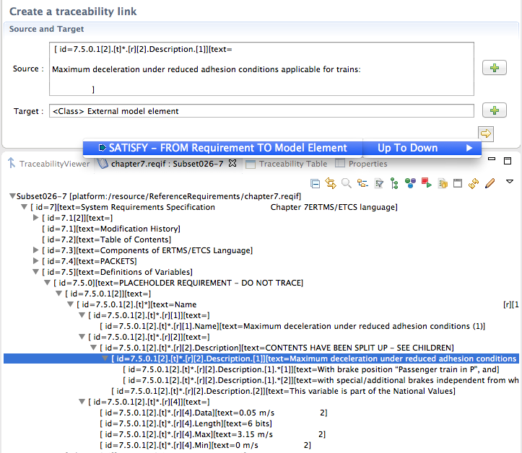

Reqcycle – prepare trace link with SCADE
Generate requirement traceability annotation for external element
Copies traceability string annotation (ReqID + Satisfy ID) to clipboard

Slide 11
3rd solution – ReqCycle only
Subset 026
1.B1 Import
Subset 026 requirements
1.A Import
1.B2 Import
OpenETCS API
2. Import
ReqCycle
Update
Reference Requirement Data Base
Link
Link
Papyrus
SCADE
7. export
RT-tester
GenDoc

Slide 12



OpenETCS current tooling context
Derive
Current traceability
User stories
User stories model
In sequence diagram
Cenelec EN50128
System requirements
OpenETCS architecture SysML model
SRS – Subset 26
OpenETCS function Scade model
Architecture and Design Document
Draft
System level requirements
Decomposed and derived requirements
Data dictionnary model
reqID in comments area
Partially done
Req gateway
code generator
C code

Slide 13
BACKUP

Slide 14
OpenETCS current process vs. standard
derive
Direct traceability
Indirect traceability
through models
User stories
Stakeholders Needs
System needs model
UC / User Stories / Operational Scenarios
Operational modes
User stories model
Cenelec EN50128
Stakeholders
requirements
System boundaries model
System main functions
Interface definitions
OpenETCS architecture (semi formal) model
System requirements
SRS – Subset 26
OpenETCS function
(formal) model
System level requirements
Data dictionnary model
System Architecture Model
Functional/logical architecture
Physical configuration items
Constraints/Equations
Allocations
Decomposed and derived requirements
Architecture and Design Document
Draft
SW building block Requirements
SW Architecture Model
Architecture / Design
code generator
SW low-level requirements
SW Code

Slide 15
OpenETCS current process vs. standard
derive
Direct traceability
Indirect traceability
through models
User stories
Stakeholders Needs
System needs model
UC / User Stories / Operational Scenarios
Operational modes
User stories model
Cenelec EN50128
Stakeholders
requirements
System boundaries model
System main functions
Interface definitions
OpenETCS architecture (semi formal) model
System requirements
SRS – Subset 26
OpenETCS function
(formal) model
System level requirements
Data dictionnary model
System Architecture Model
Functional/logical architecture
Physical configuration items
Constraints/Equations
Allocations
Decomposed and derived requirements
Architecture and Design Document
Draft
reqID in comments area
SW building block Requirements
SW Architecture Model
Architecture / Design
code generator
SW low-level requirements
SW Code

